Slide 1
OGC Testbed 21 – GIMI Standard Activity Overview
Joe Stufflebeam, Ph.D.
GEOINT Media Standards Board
NGA/TAEB Contractor
22 April 2026

Slide 2
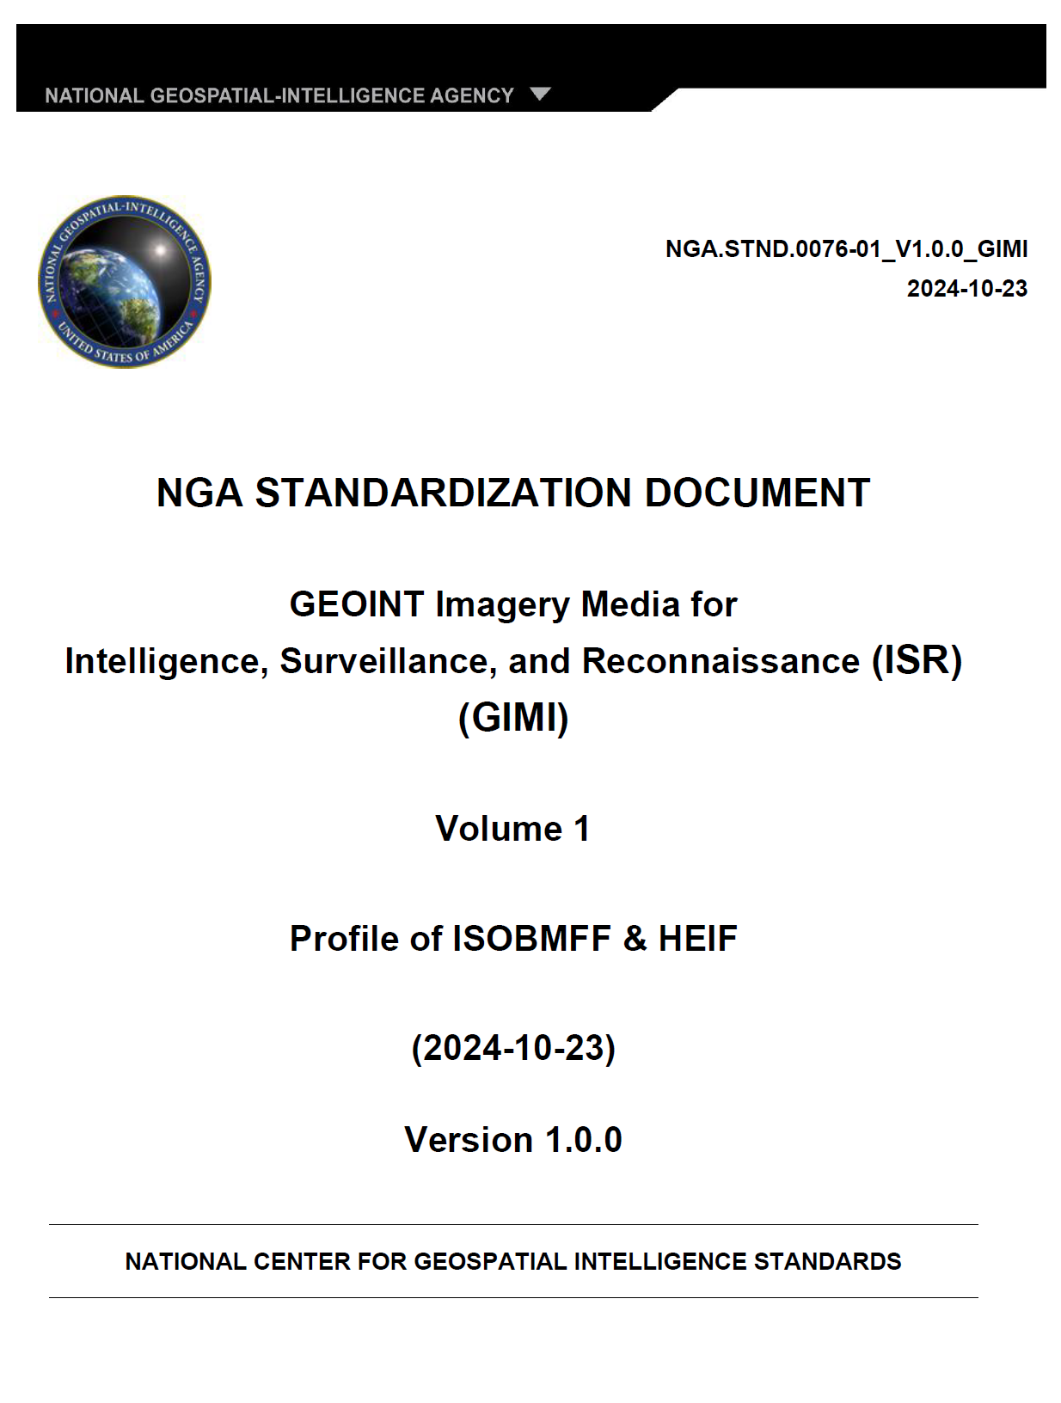
What is 'GIMI"?
GIMI stands for:
GEOINT Imagery Media for Intelligence, Surveillance, & Reconnaissance (ISR)
GIMI is:
A next generation imagery file format/container standard documented in NGA.STND.0076-01
a profile of ISOBMFF (ISO/IEC 14496-12) & HEIF (ISO/IEC 23008-12)
tightly coupled with NGA's Imagery Domain Ontologies (IDO)

Slide 3
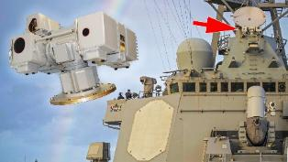



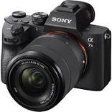
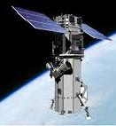
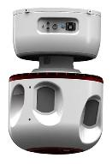
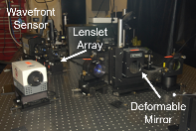

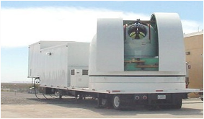


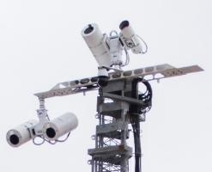

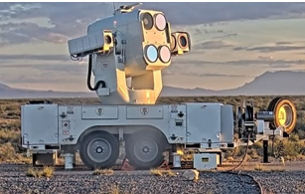

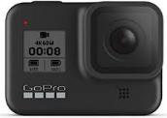
GIMI/IDO: Addressing the Future Architecture of the Imagery Domain
Broad Spectrum Imaging (UV, Vis, SWIR, MWIR, LWIR, Multi-Spectral, Hyperspectral, etc.)
“Other” Sensor/Metadata Ingest (Ranging, Orientation, Position, Temperature, Audio, etc.)
Still Imagery Systems
Class 0 Systems
Class 1 Systems
Class 2 Systems
Class 3 Systems
GIMI/IDO

Slide 4
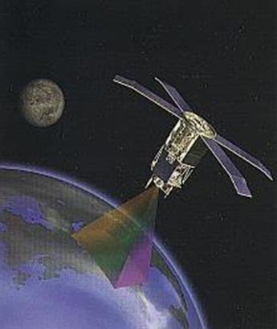
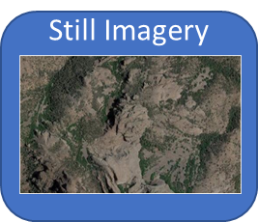
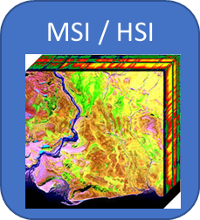


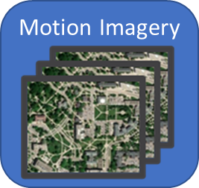

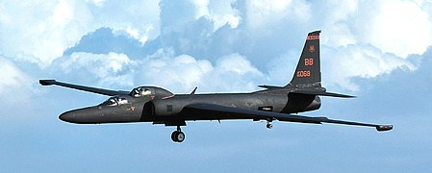
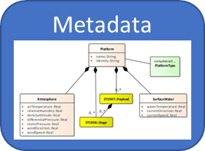




Emerging Geospatial Imagery Standards
Sensor Systems
Sensor Content
GMSB
Profiling & Tailoring to the Mission
SAR
TS, CMAF, DASH
Open Source & Commercial Software Tools
Streaming
Other Data Sources
KLV, RDF,
GraphDB, SparQL
Open Source & Commercial Software Tools
Metadata/Ontology
Uncompressed, HEVC, AVC,
JPEG2000, HTJ2K, J2K in ISOBMFF
Open Source & Commercial Software Tools
Image Encoding
HEIF
Open Source & Commercial Software Tools
Still Imagery
ISOBMFF
Open Source & Commercial Software Tools
Foundation, Motion Imagery
Notes:
NGIIS Contributions to MPEG/JPEG:
ISO/IEC 23001-17 [RAW] uncompressed video and images in ISOBMFF
Supports the carriage of uncompressed Still and Motion Imagery in MP4 and HEIF files, including calibration frames
Media content annotation with nanosecond TAI timestamps and clock metadata
Numerically, bitwise lossless media compression (gzip, etc.)
Supports use cases where image content fidelity is of paramount importance: pixel level measurement accuracy, radiometry, event timing, time-space-position-information (TSPI), etc.
ISO/IEC 23008-12 [HEIF]
Cloud optimization
Supports use cases requiring fast access and retrieval of partial media content over a network
ISO/IEC 15444-16 [JPEG 2000 in ISOBMFF]
JPEG 2000 encoding of Still and Motion Imagery content
Supports use cases requiring compression of high dynamic range imagery, large array sizes, high speed imagery, etc.
ISO/IEC 14496-12 [ISOBMFF]
Supports frame annotation of image sequences and videos including pixel level metadata

Slide 5
Imagery Domain Ontologies
The IDO provides a rich set of ontologically structured information geared toward providing descriptive information and context about GIMI imagery media content
The initial IDO effort is focused on "Image Collection" and the parameters associated with sensor systems and the entities within a scene
The IDO is part of a wider Government effort aimed at aligning data management and achieving cohesive semantic understanding across different domains

Slide 6
OGC Testbed 21 – GIMI Focused Requirements & Sprint Efforts
GIMI File Format:
Enable accelerated GIMI adoption and application development by participating in open-source additions to the GStreamer and libheif libraries
Implement and enhance cloud optimization features
Develop a GIMI Conformance Test Tool (CTTG thread)
Imagery Domain Ontology (IDO):
Investigate, implement, and evaluate the GEOINT Media Standards Board’s (GMSB) emerging Imagery Domain Ontology (IDO) by implementing and testing ontology structured metadata sidecar files
GIMI/IDO:
Develop a Cloud-based GIMI/IDO player/viewer to provide a general tool for accessing and viewing geospatial media content
Perform benchmarking to determine performance
Develop, test, measure, demonstrate, and evaluate the combination of GIMI & IDO
Conformance Testing:
Develop testing capabilities for GIMI implementations
Overall:
Provide recommendations for improvements & next steps

Slide 7
Summary
The OGC Testbed 21 is performing foundational work to enable and accelerate the availability of software tools necessary to realize the adoption and proliferation of the GIMI format and the Imagery Domain Ontologies
These new technologies have been designed to significantly improve interoperability and technical capabilities across the broad spectrum of geospatial imagery applications and users
The GEOINT Media Standards Board (GMSB) is very appreciative of the efforts and successes being achieved and demonstrated by OGC and the Testbed 21 participants
The impact and benefits derived from these efforts is significant and many thanks go out to the OGC leadership and participants in the GIMI/IDO efforts for their hard work and successful achievements.
Enjoy the upcoming code sprint!

Slide 8
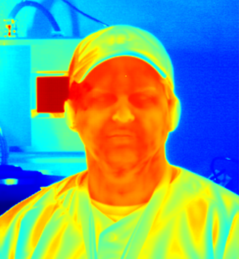
Joe Stufflebeam, Ph.D.
GEOINT Media Standards Board
NGA-TAEB Contractor Joe.stufflebeam@teknicare.com

